Slide 1
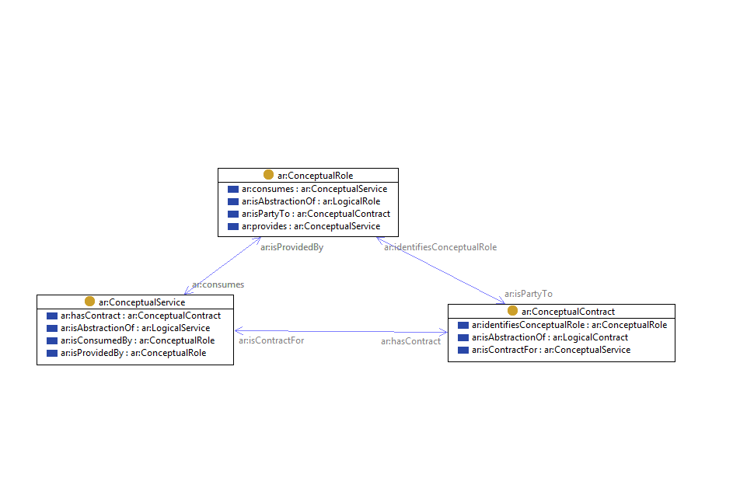
Conceptual View, v1

Slide 2
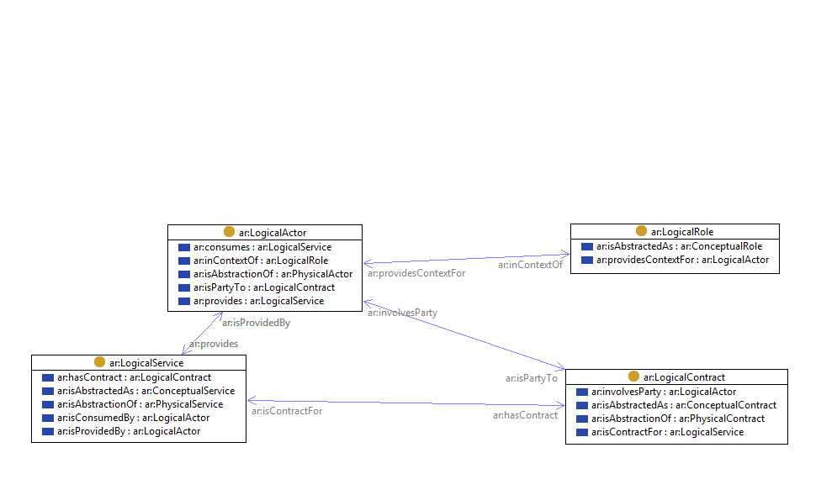
Logical View, v1

Slide 3
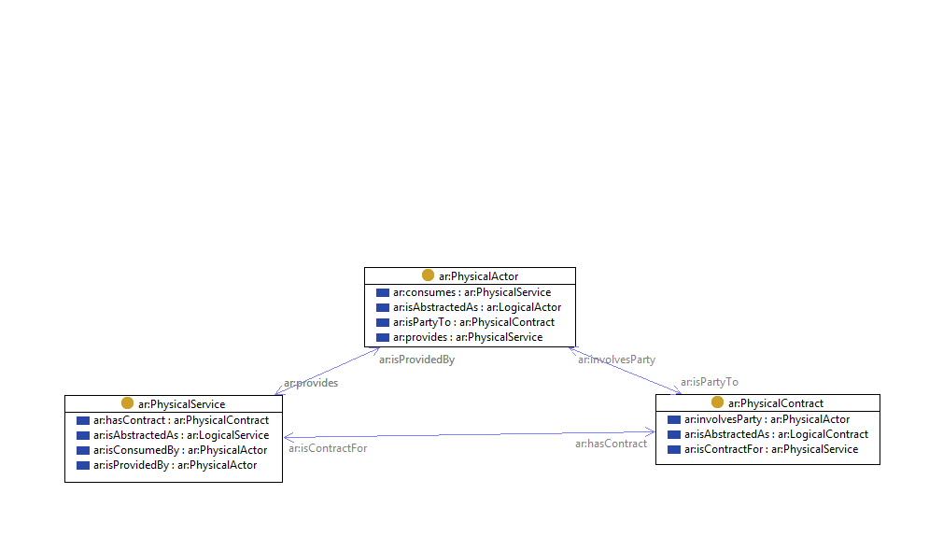
Physical View, v1

Slide 4

Fact Statements, v1

